Slide 1
Data Structures & Algorithms
LuatNT/HoangND1

Slide 2
Agenda
Data Structure
Analysis of algorithms
Non-primitive data structures
Array
Linked list
Binary tree
General tree
Heap
Queue
Stack
Sorting Algorithms
Searching Algorithms

Slide 3
Data Structure
What is Data Structure?
A data structure is a particular way of organizing data so that it can be used efficiently.
E.g. book, video, music, …
Data Structure = Organized Data + Allowed Operations.
In computer science, it is the way data is organized to ensure efficient processing (storing, accessing, finding, adding, removing, …): this may be in lists, arrays, stacks, queues, trees or other formats.

Slide 4
Data Structure (Cont.)
Data structures can be classified in to 2 types
Primitive data structures
These are data structures that can be manipulated directly by machine instructions.
In C language, the different primitive data structures are int, float, char, double.
Non-primitive data structure
These are data structures that can not be manipulated directly by machine instructions. Arrays, linked lists, files etc., are some of non-primitive data structures and are classified into linear data structures and non-linear data structures.

Slide 5
Data Structure (Cont.)
Every data structure has 2 design aspects
The interface part
The publicly accessible functions of the type. Functions like creation and destruction of the object, inserting and removing elements (if it is a container), assigning values etc.
The implementation part
Internal implementation should be independent of the interface. Therefore, the details of the implementation aspect should be hidden out from the users.

Slide 6
Analysis of algorithms
What is analysis of algorithms?
The analysis of algorithms is the determination of the amount of resources (such as time and storage) necessary to execute them.
Usually, the efficiency or running time of an algorithm is stated as a function relating the input length to the number of steps (time complexity) or storage locations (space complexity).
Big O notation, is used to present analysis of algorithms.

Slide 7
Analysis of algorithms (Cont.)
Analysis of algorithms in programming
Simple statement sequence
statement_1;
statement_2;
…
statement_m;
Complexity is O(1) as long as k is constant
Simple loops
for(i = 0; i < n; i++)
{
s; //s is O(1)
}
Complexity is nO(1) or O(n)

Slide 8
Analysis of algorithms (Cont.)
Analysis of algorithms in programming
Loop index doesn’t vary linearly
h = 1; while(h <= n)
{
s; //s is O(1)
h = 2 * h;
}
Complexity O(logn)
Nested loops (loop index depends on outer loop index)
for(i = 0; i < n; i++)
for(j = 0; j < n; j++)
{
s; //s is O(1)
}
Complexity is n O(n) or O(n²)

Slide 9
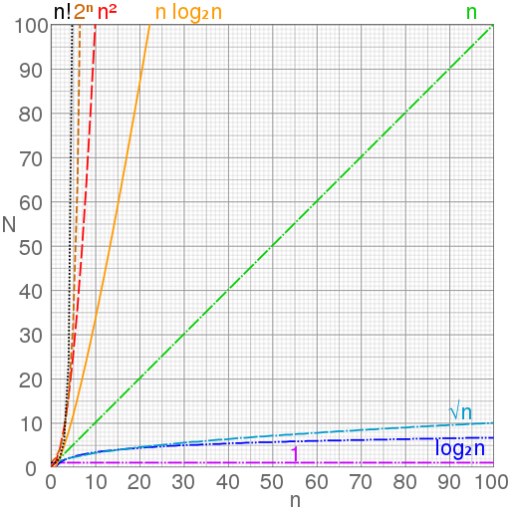
Analysis of algorithms (Cont.)
Analysis of algorithm in mathematic theory

Slide 10
Array
What is array?
Array is a data structure consisting of a collection of elements (values or variables), each identified by at least one array index or key
Each object in an array is called an array element.
Each element has the same data type (although they may have different value).
Individual elements are accessed by index using a consecutive range of integers.

Slide 11
Array (Cont.)
One Dimensional Array or vector
A one dimensional array is a collection of items which is accessed via 1 subscript expressions. For example, in a language that supports it, the (i)th element of the two-dimensional array x is accessed by writing x[i].
One dimensional array in C:
int A[10];
A[0] = 1; //ok
A[5] = 6; //ok
A[7] = 1.2; //error
A[0] 1 | A[1] 2 | A[2] 3 |  |  |  | A[n-2] N-1 | A[n-1] N

Slide 12
Array (Cont.)
Multi-dimensional Array
A multi-dimensional array of dimension n (i.e. an n-dimensional array or simply n-D array) is a collection of items which is accessed via n subscript expressions. For example, in a language that supports it, the (i,j,k,…)th element of the n-dimensional array x is accessed by writing x[i,j,k,…].
Two dimensional array in C:
int A[3][3];
A[0][0] = 1; //ok
A[1][2] = 6; //ok
A[2][0] = 1.2; //error
A[0][0] | A[0][1] | A[0][2]
A[1][0] | A[1][1] | A[1][2]
A[2][0] | A[2][1] | A[2][2]

Slide 13
Linked List
What is linked list?
Linked list is a linear collection of data elements, called nodes, each pointing to the next node by means of a pointer.
Each node of the list contains
The data item
A pointer to the next node
The last node in the list contains a NULL
pointer to indicate that it is the end or
tail of the list.
Data
Next
object

Slide 14
Linked List (Cont.)
How to manipulate with linked list
Initialize list by creating a pointer to the list’s head
Initially as a NULL pointer
Add first item
Allocate space for node
Set its data pointer to object
Set Next pointer to NULL
Set Head to point to new node
Collection
node
Head
Data
Next
Tail
object

Slide 15
Linked List (Cont.)
Linked list variations
Simplest implementation
Add to head
Last-In-First-Out (LIFO)
Modifications
Keep a tail pointer
Add to tail
First-In-First-Out (FIFO)
By ensuring that the tail of the list is always pointing to the head, we can build a circularly linked list
Head is tail->next
LIFO or FIFO using ONE pointer
head
tail

Slide 16
Linked List (Cont.)
Doubly linked list
Can be scanned in both directions
Each node need 1 more pointer which points to previous node
Applications requiring both way search
E.g. Name search in telephone directory
head
prev
prev
prev
tail

Slide 17
Binary Tree
What is binary tree?
A binary tree is a tree data structure in which each node has at most two children, which are referred to as the left child and the right child.
The first node of tree is called root node.
The nodes at the lowest levels of the tree (the ones with no sub-trees) are called leaves.
Recursive definition: A binary tree is a tree that is created from 2 binary sub-trees.
A
B
C
D
E
F
G

Slide 18
Binary Tree (Cont.)
Ordered binary tree
The keys value of all the nodes in the left sub-tree are less than the key value of the root node.
The keys of all the nodes in the right sub-tree are greater than the key value of the root node.
The left and right sub-trees are themselves ordered binary trees.
A
B
C
D
E
F
G

Slide 19
Binary Tree (Cont.)
Characteristics of binary tree
If A is the root of a binary tree and B is the root of its left/right subtree then
A is the father of B
B is the left/right son of A
Two nodes are brothers if they are left and right sons of the same father.
Node n1 is an ancestor of n2 (and n2 is descendant of n1) if n1 is either the father of n2 or the father of some ancestor of n2.
A
B
C
D
E
F
G

Slide 20
Binary Tree (Cont.)
Characteristics of binary tree (Cont.)
Strictly Binary Tree: If every non-leaf node in a binary tree has non empty left and right sub-trees.
Level of a node: Root has level 0. Level of any node is one more than the level of its father.
Depth: Maximum level of any leaf in the tree
A
B
C
D
E
F
G

Slide 21
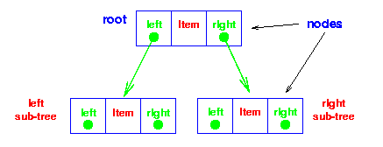
Binary Tree (Cont.)
Characteristics of binary tree (Cont.)
Each node of a binary tree contains:
The data item
A pointer points to left child node
A pointer points to right child node
Leave nodes in the tree contains 2 NULL pointer to indicate they are leave nodes

Slide 22
General Tree
What is general tree?
A tree is a finite nonempty set of elements in which one element is called the ROOT and remaining element partitioned into m >=0 disjoint subsets, each of which is itself a tree
Different types of trees: binary tree, n-ary tree, red-black tree, AVL tree
A Hierarchical Tree

Slide 23
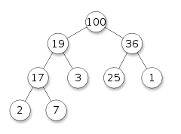
Heap
What is heap?
A heap is a specialized tree-based data structure that satisfies the heap property: If A is a parent node of B then the key (the value) of node A is ordered with respect to the key of node B with the same ordering applying across the heap
Different types of heap: max-heap, min-heap

Slide 24
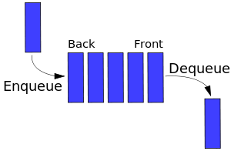
Queue
What is queue?
A queue is a particular kind of abstract data type or collection in which the entities in the collection are kept in order and the principal (or only) operations on the collection are the addition of entities to the rear terminal position, known as enqueue, and removal of entities from the front terminal position, known as dequeue.

Slide 25
Queue (Cont.)
Type of queue
FIFO queue
A queue in which the first item added is always the first one out.
Priority queue
A queue in which the items are sorted so that the highest priority item is always the next one to be extracted.
Queue can be implemented by using array or linked list

Slide 26
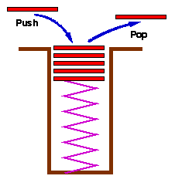
Stack
What is stack?
A stack is an abstract data type that serves as a collection of elements, with two principal operations: push, which adds an element to the collection, and pop, which removes the most recently added element that was not yet removed.
Stack is actually a LIFO queue.
Stack can be implemented by array or linked list

Slide 27
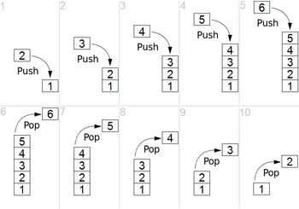
Stack (Cont.)
How stack works

Slide 28
Data Structure Comparisons
 | Array Simple, fast Inflexible | Linked list Simple Flexible | Tree Still simple Flexible
Add | O(1) | O(1) | O(logn)
Delete | O(n) | O(n) | O(logn)
Find | O(n) | O(n) | O(logn)

Slide 29
Sorting Algorithms
What is sorting algorithm?
A sorting algorithm is an algorithm that puts elements of a list in a certain order.
Why do we need to sort a list?
To find element(s) faster

Slide 30
Sorting Algorithms (Cont.)
Types of sorting
Exchange Sorts
Bubble Sort
Quick Sort
Insertion Sorts
Selection Sorts
Heap Sort
Binary Tree Sort
Other algorithms

Slide 31
Bubble Sort
Algorithm
Compare adjacent elements. If the first is greater than the second, swap them.
Do this for each pair of adjacent elements, starting with the first two and ending with the last two.
After the first round, the last element should be the greatest.
Keep repeating for one fewer element each round, until we have no more pairs to swap.
Time complexity: O(n2)

Slide 32
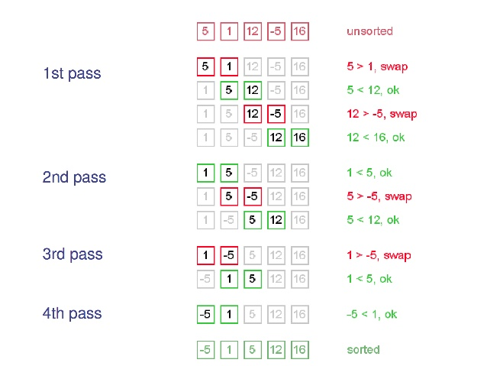
Bubble Sort (Cont.)
Bubble sort example

Slide 33
Quick Sort
Algorithm
Choose the highest index element as pivot.
Take two variables to point left and right of the list excluding pivot. Left points to the low index, right points to the high index.
While value at left is less than pivot move right
While value at right is greater than pivot move left.
If both above steps do not match swap left and right
if left ≥ right, the point where they met is new pivot.
Time complexity: O(nlogn) or O(n2)

Slide 34
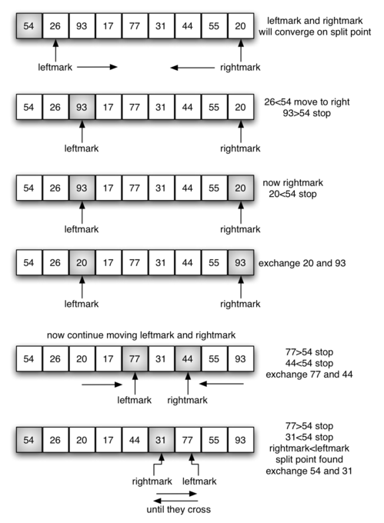
Quick Sort (Cont.)
Quick sort example

Slide 35
Insertion Sort
Algorithm
Start with the sorted sub-list being the first element of the input list.
Pick next element from the input list and compare with all elements in the sorted sub-list.
Shift all the elements in the sorted sub-list that is greater than the element to be sorted 1 room right and fill the element in the new blank room.
Start again from step 2 until the input list is empty.
Time complexity: O(n2)

Slide 36
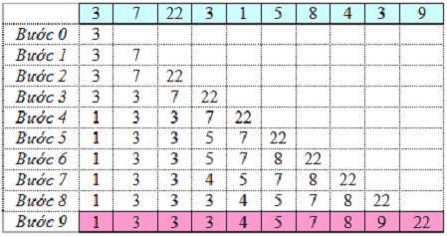
Insertion Sort (Cont.)
Insertion sort example

Slide 37
Selection Sort
Algorithm
Set the first position as the MIN position.
Search the minimum element from MIN position to end of the list, if found, swap it with element at position MIN.
Set the position after the current MIN position as new MIN position.
Start again from step 2 until the list is sorted.
Time complexity: O(n2)

Slide 38
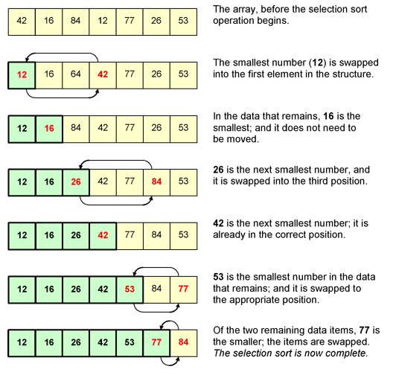
Selection Sort (Cont.)
Selection sort example

Slide 39
Heap Sort
Algorithm
Construct a heap to hold element of input list.
Add each item to the heap (maintaining the heap property).
when all items have been added, remove them one by one (restoring the heap property as each one is removed).
Addition and deletion are both O(logn) operations. We need to perform n additions and deletions, leading to an algorithm with time complexity O(nlogn)
Actually, heap sort is slower than theory.

Slide 40
Comparison of algorithms
Algorithm | Time complexity | Note
Bubble | O(n2) | Guaranteed
Insertion | O(n2) | Guaranteed
Heap | O(nlogn) | Guaranteed
Quick | O(nlogn) | Most of the time
 | O(n2)
Binary tree short | O(nlogn)
Reference: https://en.wikipedia.org/wiki/Sorting_algorithm#Bubble_sort

Slide 41
Searching Algorithms
What is searching algorithm
A search algorithm is an algorithm that retrieves information stored within some data structure.
Data structures can include linked lists, arrays, search trees, hash tables, or various other storage methods. The appropriate search algorithm often depends on the data structure being searched.
Aspects to evaluate a searching algorithm
The average time
The worst-case time
The best possible time

Slide 42
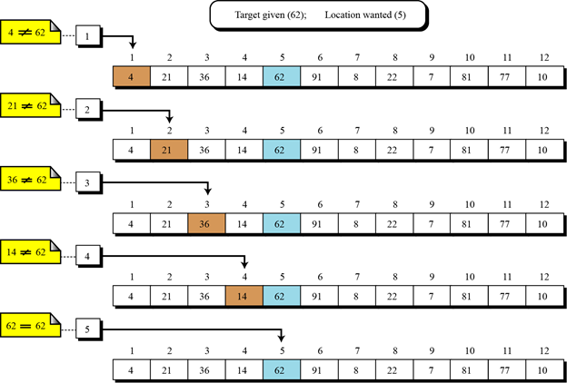
Sequential Search
What is sequential search?
Sequential sequentially checks each element of the list for the target value until a match is found or until all the elements have been searched.

Slide 43
Sequential Search (Cont.)
Complexity
Space complexity: O(1)
Time complexity:
 |  | Best | Worst | Average
Unsorted list | Item is present | 1 | n | n/2
 | Item is not present | n | n | n
Sorted list | Item is present | 1 | n | n/2
 | Item is not present | 1 | n | n/2

Slide 44
Sequential Search (Cont.)
Methods to improve sequential search
Static caching
store the most often accessed elements at the first places
Dynamic caching
For each access, move the element to the first position

Slide 45
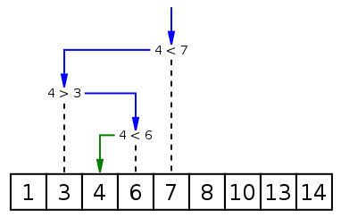
Binary Search
What is binary search?
Binary search is a search algorithm that finds the position of a target value within a sorted array. It compares the target value to the middle element of the array; if they are unequal, the half in which the target cannot lie is eliminated and the search continues on the remaining half until it is successful.

Slide 46
Binary Search (Cont.)
Complexity
Space complexity: O(1)
Time complexity:
Best case: O(1)
Worst case: O(1)
Average case: O(logn)

Slide 47
Binary Search vs Sequential Search
 | Worst case time
Sequential search | c1 n
Binary search | c2 log2n
Small
problems -
we’re not
interested!
n
Large
problems -
we’re
interested
in this gap!
log₂n

Slide 48
Thank you for watching!
Q & A

